Slide 1

Green Pace
Security Policy Presentation
Developer: Kendall Ferebee

Slide 2

OVERVIEW: DEFENSE IN DEPTH
Security policy is a collection of standards and best practices to maintain the safety of our software and data. The different parts of this policy makes up some of the layers the Defense in Depth strategy.

Slide 3
THREATS MATRIX
Likely: Likely to happen with low severity
Unlikely: Unlikely to happen with high severity
Low Priority: Unlikely to happen with low severity
Priority: Likely to happen with high severity
Likely STD-001-CPP STD-002-CPP STD-007-CPP | Priority STD-003-CPP STD-004-CPP STD-005-CPP
Low priority STD-006-CPP STD-008-CPP | Unlikely STD-006-CPP STD-008-CPP

Slide 4
10 PRINCIPLES
Validate Input Data : STD-001-CPP, STD-008-CPP
Heed Compiler Warnings: STD-010-CPP, STD-006-CPP
Architect and Design for Security Policies : STD-002-CPP
Keep It Simple: STD-007-CPP
Default Deny: STD-005-CPP
Adhere to the Principle of Least Privilege: STD-009-CPP
Sanitize Data Sent to Other Systems: STD-004-CPP
Practice Defense in Depth : STD-003-CPP, STD-007-CPP
Use Effective Quality Assurance Techniques: STD-006-CPP, STD-007-CPP
Adopt a Secure Coding Standard: STD-005-CPP, STD-001-CPP

Slide 5
CODING STANDARDS
SQL Injection: STD-004-CPP - Prevent SQL injection by using prepared statements and parameterized queries to safeguard against malicious attacks.
Memory Protection : STD-005-CPP - Detect and handle memory allocation errors to avoid memory leaks and segmentation faults.
String Correctness : STD-003-CPP - Always perform range checks on element access to prevent buffer overflows and data corruption.
Object Oriented Programming: STD-008-CPP - Write constructor member initializers in the canonical order to improve readability and prevent errors.
Data Type : STD-001-CPP - Avoid ambiguous declarations to ensure clarity and correctness in data representation.
Input Output (I/O): STD-009-CPP - Close files when they are no longer needed to avoid resource leaks and potential system crashes.
Exception : STD-007-CPP - Never abruptly terminate the program. Ensure proper exception handling to maintain stability and graceful error recovery.
Data Value : STD-002-CPP - Never access an object outside of its lifetime, as this can lead to undefined behavior or system instability.
Declaration: STD-010-CPP - Follow the one-definition rule to ensure that variables are declared and initialized correctly, preventing conflicting definitions.
Assertions : STD-006-CPP - Use static assertions to test the value of constant expressions during compilation, ensuring correctness early in the development process

Slide 6
ENCRYPTION POLICIES
Encryption at Rest – Ensures that data is encrypted when stores.
Encryption at Flight – Ensures that data is encrypted while being transmitted.
Encryption in Use – Ensure that sensitive data is encrypted at all stages.

Slide 7
TRIPLE-A POLICIES
Authentication – involves confirming the right person is accessing the system.
Authorization – refers to an authenticated user’s right and privileges.
Accounting – monitoring activates and recording actions for compliance and security purposes.

Slide 8
Unit Testing

Slide 9
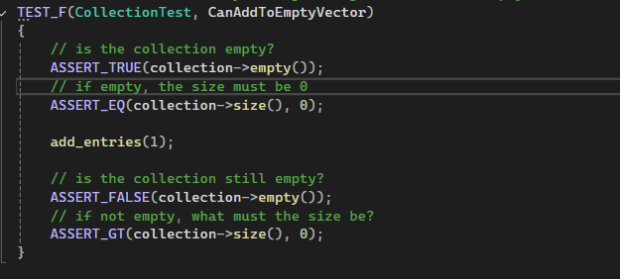
Unit Testing

Slide 10

Unit Testing

Slide 11
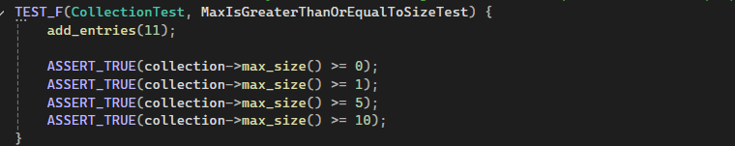
Unit Testing

Slide 12

AUTOMATION SUMMARY

Slide 13
TOOLS
DevSecOps pipeline integrates security practices, such as scanning, policy enforcement, and compliance validation, into every stage of development, ensuring security is embedded throughout the software development lifecycle rather than added as an afterthought.
External Tools and Usage:
Static Analysis Tools (e.g., SonarQube, Checkmarx): Used in the Develop and Build stages to detect vulnerabilities in source code.
Dynamic Analysis Tools (e.g., OWASP ZAP, Burp Suite): Deployed during the Test phase to scan applications in runtime.
CI/CD Tools (e.g., Jenkins, GitLab CI): Automate the pipeline, ensuring security checks are integrated across stages.
Container Security Tools (e.g., Aqua, Twistlock): Monitor and scan containerized applications in the Deploy and Operate phases.
Monitoring Tools (e.g., Splunk, Datadog): Used in the Operate stage for continuous security logging and monitoring.

Slide 14
RISKS AND BENEFITS
Act now or wait?
Benefits
Preventative nature
Saves money lost in case of security breach
Early implementation is more effective
Greater layer of defense against attackers
Risk
Upfront Cost
Labor Hours
Experience required
Adds a layer of complexity to management and production
Notes:
Should you act now or wait?
Software and systems will always have risks, especially with new technologies. These can be mitigated through practices like the Triple-A and Defense in Depth, which strengthen defenses, reduce breach costs, and identify vulnerabilities early. Implementing security from the outset makes systems more resilient.
However, some challenges include upfront costs, labor, and added complexity to management impacting workflows. But despite these, the long-term benefits—reduced threats, cost savings, and stronger systems—make early adoption a strategic choice.

Slide 15
RECOMMENDATIONS
Keep policies clear, consistent, and easy to follow
Security principles should be integrated throughout the development process
Updating dependencies regularly to avoid known vulnerabilities.
Scanning for vulnerabilities frequently to address issues quickly.
Encrypting sensitive data to protect it during storage and transmission.
Applying the Principle of Least Privilege by granting only necessary access.
Notes:
While establishing rules are important, effectively communicating them to programmers can be challenging. Therefore, it's essential to keep policies clear, consistent, and easy to follow. Rather than relying on occasional audits, security principles should be integrated throughout the development process. Regularly updating dependencies, scanning for vulnerabilities, encrypting sensitive data when necessary, and applying the Principle of Least Privilege ensure that security remains a continuous focus, helping to protect systems from emerging threats.

Slide 16
CONCLUSIONS
Security must be considered from the beginning
Training must be provided on security and the security policy
Enforcement mechanisms should be in place to ensure the security policy is followed
Security policy should be regularly reviewed and updated as needed
Notes:
With the standards outlined in this presentation and the guidelines provided in the security specification, we can effectively implement and enforce best practices to prevent security threats. However, security must be integrated at all levels. For any specification or standard to be successful, it requires full buy-in from everyone involved, ensuring that best practices are consistently applied across all systems and software.

Slide 17
REFERENCES
Foster, S. (2021, January 22). DevSecOps Pipeline Overview: DevSecOps Simplified. Perforce Software. https://www.perforce.com/blog/kw/devsecops-pipeline-overview.
Kirsh, A. (2022, August 16). Top 10 secure C++ coding practices.

